Slide 1
CSE 4539 (CSE) / CSE 4581 (BScTE (2yr) 1st Sem)
: Web Programming
Forms in HTML
Department of Computer Science and Engineering
Islamic University of Technology
Notes:
Assalamualaikum, good day my respected teachers, audiences. Today I am going to present my thesis paper titled “Class Specific feature Selection for High Dimensional low sample size Data”. I am Nazmul haque and my supervisor is Dr. Mohammad Shoyaib.
Before going in detail about my Literature review, I would like to give an outline of my whole presentation.

Slide 2
Contents
Contents
HTML (Forms)

Slide 3
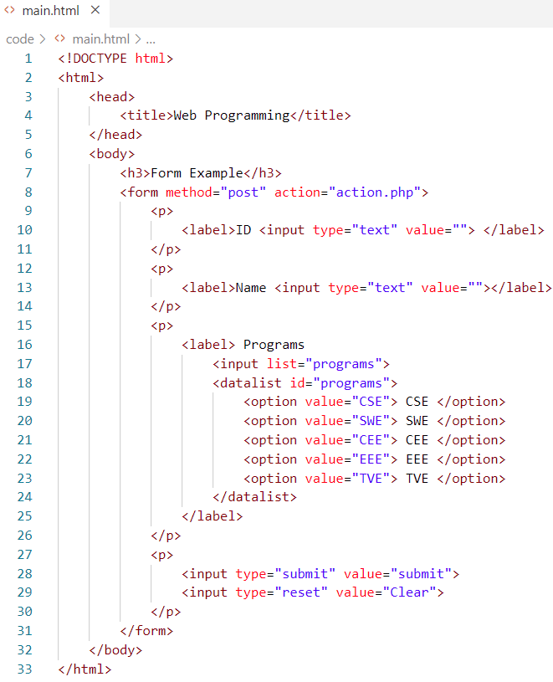
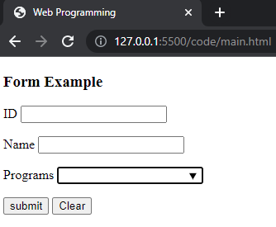
HTML
Form
Collecting data from user

Slide 4
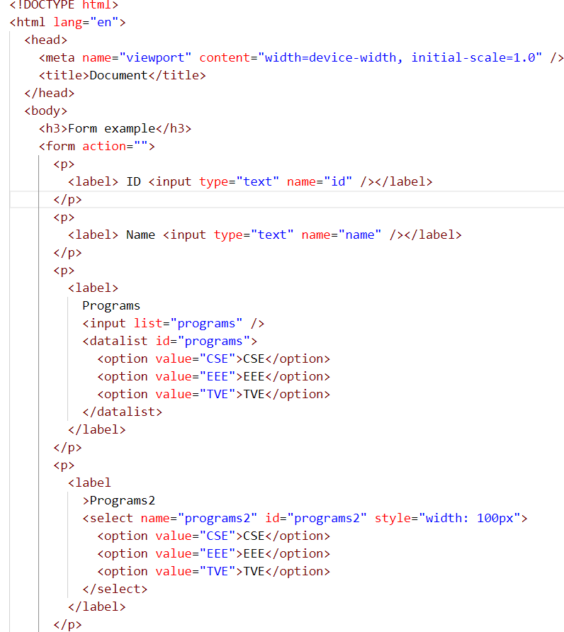
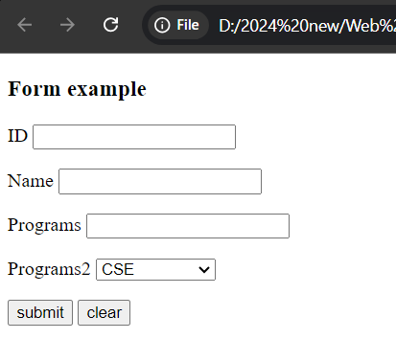
HTML
Form
Collecting data from user

Slide 5
HTML
Form: method attributes
method="post": appends the form data to the browser request. the user doesn’t see the data after the form is submitted.
method = "get", appends the form data directly to the end of the URL of the script, where it’s visible in the browser’s Address field.

Slide 6
HTML
Form: action attributes
Specifies the URL of a script on the web server that will be invoked to process the form’s data.

Slide 7
HTML
Form: input types
color
date
datetime
textarea
email
month
number
time
url, etc.

Slide 8
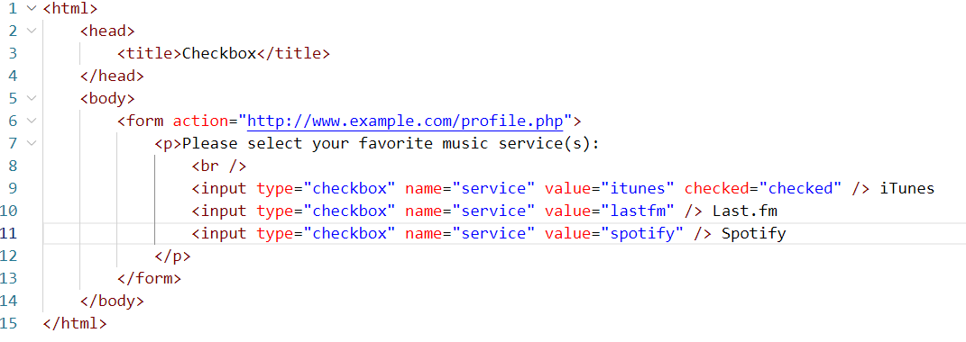
HTML
Form: Checkbox

Slide 9
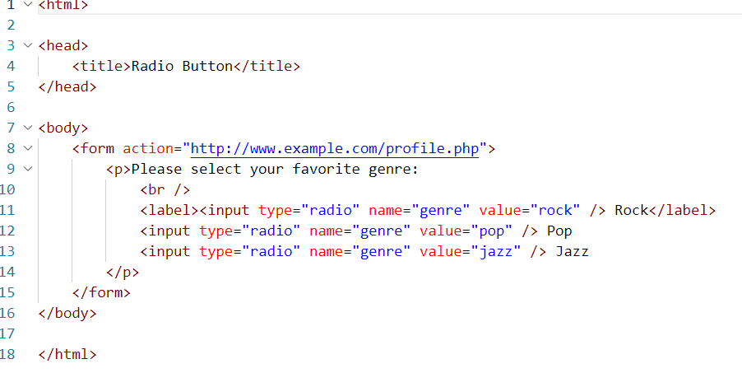
HTML
Form: Radio

Slide 10
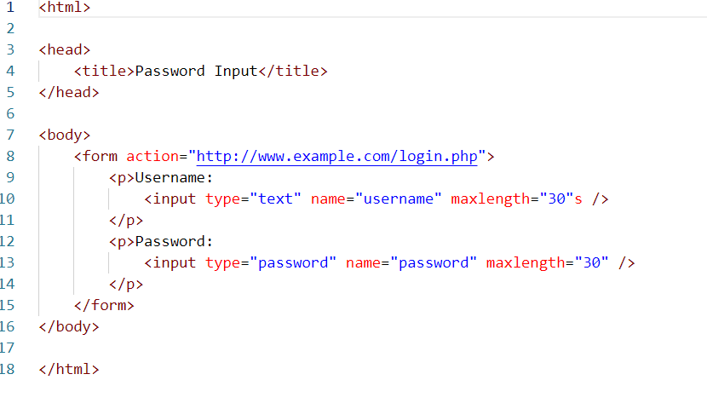
HTML
Form: Password

Slide 11
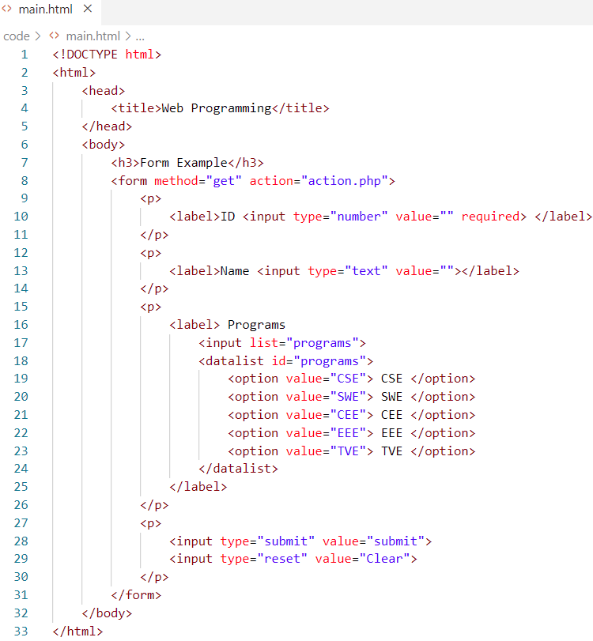
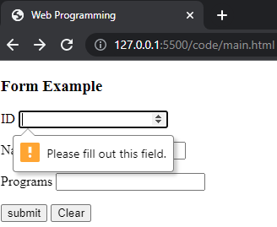
HTML
Form: Type and required field
Accept the valid input

Slide 12
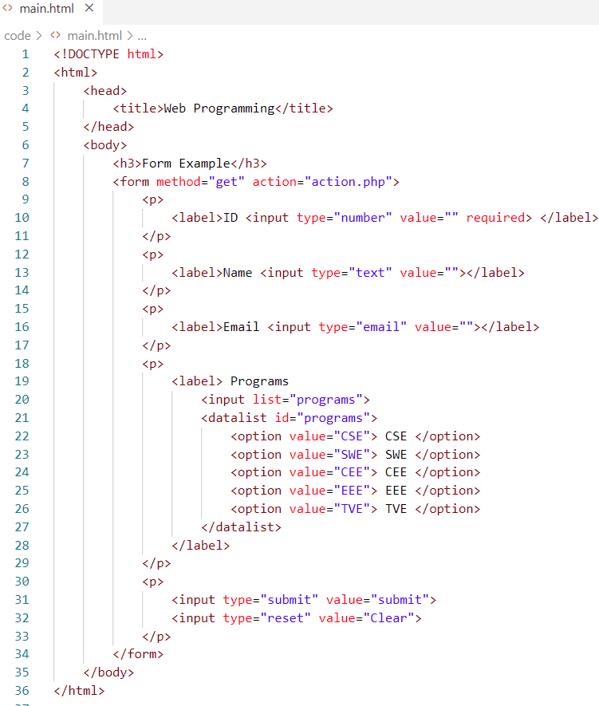
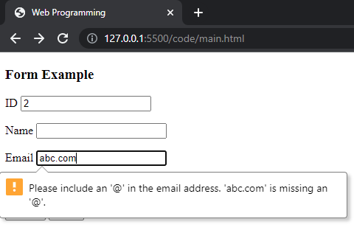
HTML
Form: Type and required field
Accept the valid input

Slide 13
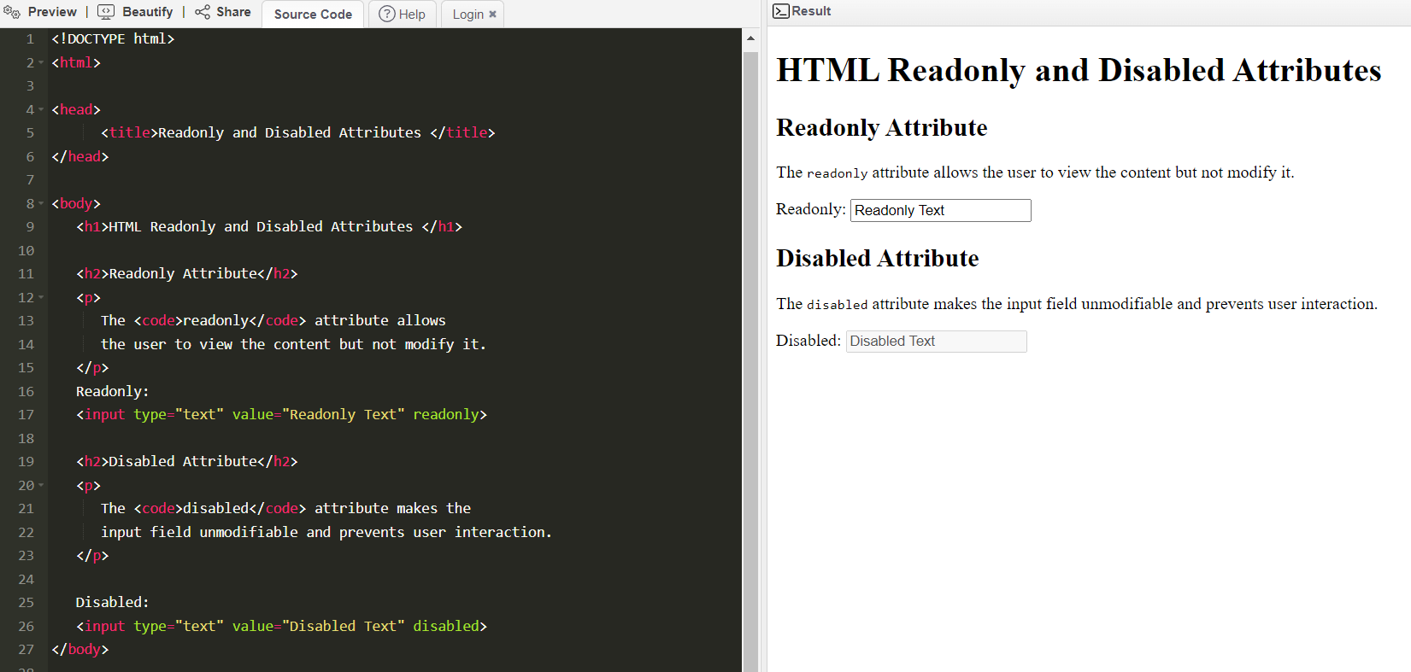
HTML
Form: field
Diabled or readonly

Slide 14
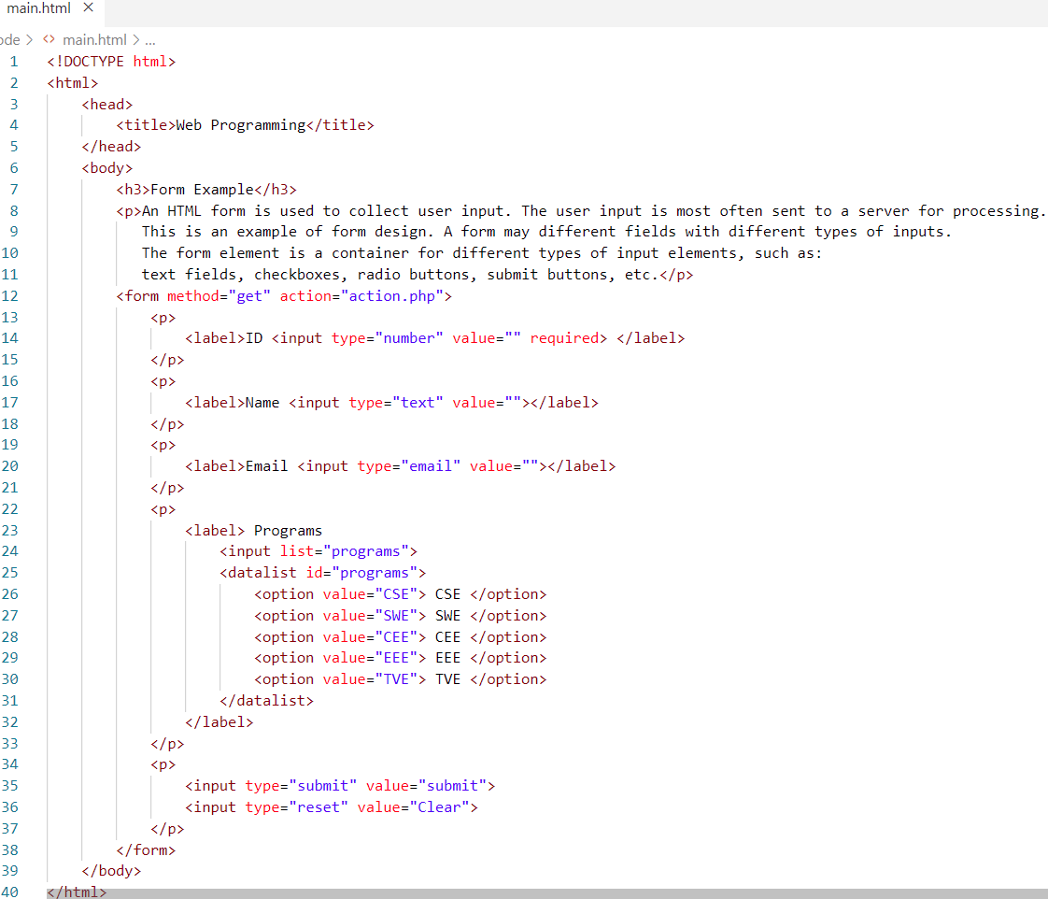
HTML
Responsive page
Creating web pages that look good on all devices!

Slide 15
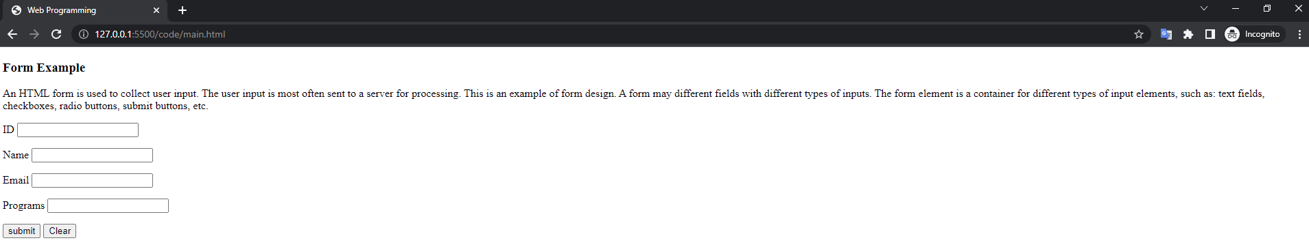
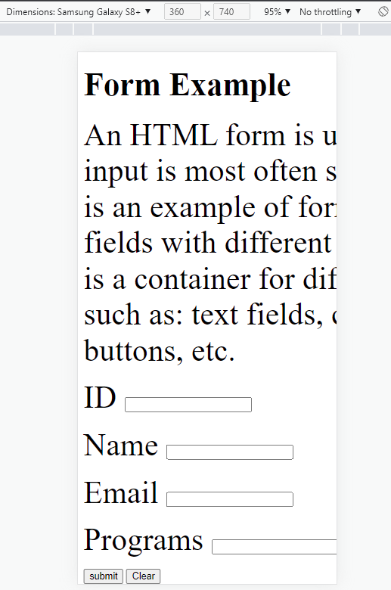
HTML
Responsive page
Creating web pages that look good on all devices!
Fig: Output from a PC
Not Responsive!
Fig: Output from a Samsung Galaxy

Slide 16
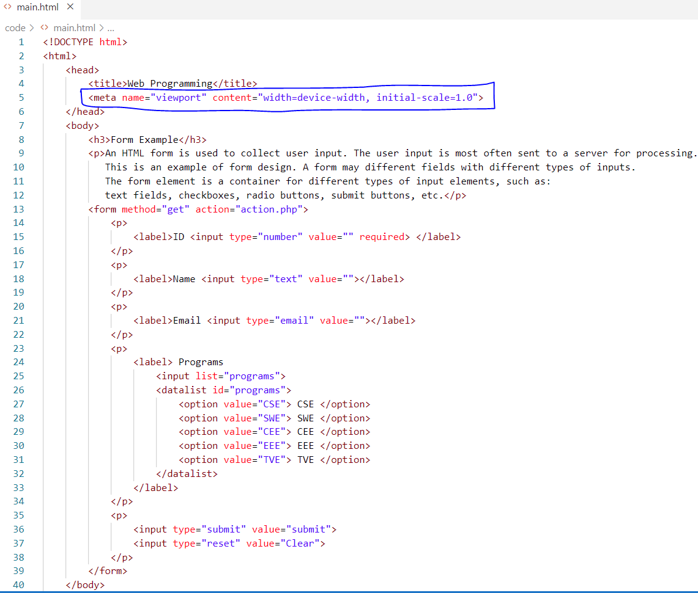
HTML
Responsive page

Slide 17
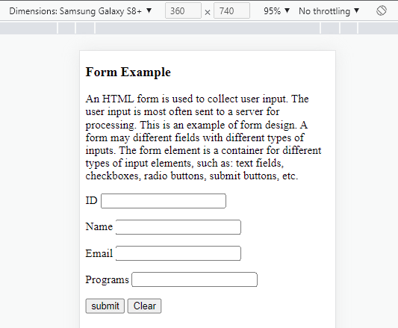
HTML
Responsive page
Creating web pages that look good on all devices!
Not Responsive!
Fig: Output from a Samsung Galaxy-responsive vs not responsive

Slide 18
ANY QUESTION ?
THANK YOU !

Slide 19
References
References
[1] W3school.com

